Slide 1
Interpersonal Awareness
Al Noel
Principal Consultant

Slide 2

Why Discuss Interpersonal Awareness? Global Relationship Study - What People Around the World Say About Microsoft
Perceived Strengths:
Optimism – an attitude that says “anything is possible”
Adaptability – a passion for being on the “cutting edge”
Highly motivated to deliver excellence. Intend to provide customers and partners with excellent value and service.
☺
Perceived Weaknesses:
Lacks empathy, care and concern for customers and partners (most frequently cited concern)
Arrogant (globally, the most common stereotype associated with Microsoft culture)
Lacks listening skills
Self-Serving
We ask for a lot of feedback and rarely communicate that we have heard the message or will make changes as a result
☹

Slide 3
Four Core Competencies Regardless of Role
Confidence
Cross Boundary Collaboration
Interpersonal Awareness
Impact and Influence

Slide 4
Definition of Interpersonal Awareness
Interpersonal Awareness is the desire to understand other people. It is the ability to accurately hear and understand others' spoken and unspoken or partly expressed thoughts, feelings, and concerns.
People who exhibit this competency understand the reasons for another's behavior, even when that behavior is subtle or complex.

Slide 5
Key to Interpersonal Awareness
Desire to understand other people

Slide 6
Empathy, not Sympathy
Sympathy – feeling sorry for someone else
Empathy – means demonstrating an understanding of the other person’s feelings, condition or point of view
Empathy = Understanding

Slide 7
Platinum Rule
Golden Rule
“Do unto others as you would have them do unto you”
Platinum Rule
“Do unto others as they would do unto themselves”
Learn how others want to be treated, and then treat them as such.

Slide 8
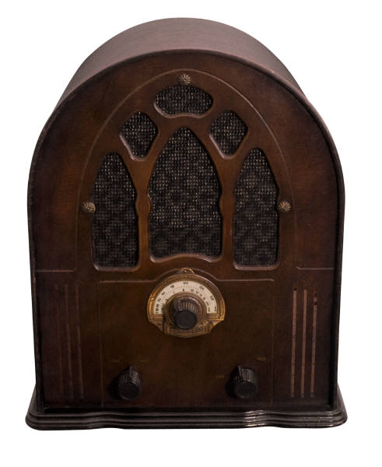
What Radio Station Are You Tuned To? WIFM or WIFT?
WIFM
What’s in it for me?
WIFT
What’s in it for them?

Slide 9
Proficiency Level 1
Recognizes others' emotions by reading body language, facial expressions, and/or tone of voice
Asks questions to understand others' concerns, behaviors, and perspectives
Listens for what is important to others; acknowledges their perspectives

Slide 10
Proficiency Level 2
Integrates understanding of others' emotions as well as the content of what they're saying into his or her interpretation of situations
Understands less-obvious reasons for others' concerns, behavior, and perspectives
Understands others' attitudes and behavior

Slide 11
Proficiency Level 3
Understands others' poorly expressed thoughts and concerns as well as their underlying meanings
Makes inferences about others that go beyond explicit content and emotion
Recognizes different values and styles, and respects others' unique characteristics or strengths

Slide 12
Proficiency Level 4
Demonstrates an in-depth understanding of the ongoing reasons for others' behavior, styles, or responses; uses this understanding to enhance interactions
Makes appropriate assessments of others' specific strengths and weaknesses based on a deeper understanding of the individual
Respects other perspectives and recognizes value in what others provide, even when their skills, styles, and approaches are different from his or her own

Slide 13
Another Definition – Interpersonal Skills
Interpersonal skills are the skills that a person uses to interact with other people.
Also referred to as people skills, social skills or communication skills.
Interpersonal skills involve using skills such as active listening and tone of voice
Help people further their careers

Slide 14
Benefits of Good Interpersonal Awareness/Interpersonal Skills
Having positive interpersonal skills increases the productivity in the organization since the number of conflicts is reduced.
In informal situations, it allows communication to be easy and comfortable.
People with good interpersonal skills can generally control the feelings that emerge in difficult situations and respond appropriately, instead of being overwhelmed by emotion and reacting.
Allows you to respond, not react

Slide 15


People Skills
Often described as:
Understanding ourselves and moderating our responses, not reacting (Don’t let your alligator mouth over load your hummingbird rear end!)
Talking effectively and empathizing accurately
Building relationships of trust, respect and productive interactions

Slide 16
AKA “Social Skills”
Any skill facilitating interaction and communication with others
Social rules and relations are created, communicated, and changed in verbal and nonverbal ways

Slide 17

Misunderstandings in Communication
Happen because meanings are in our heads, not in the words we speak
Meaning is in people heads and not in words,
Points of view are in individual heads, not in the information presented
Draw a picture of happy
My pet rat “Happy” ☺

Slide 18
Interpersonal Communication
What is it?
Interpersonal communication involves a close group of participants.
The everyday conversations you carry on
General friendly exchanges, arguments and basically anytime you speak to someone
Something most of us do on a daily basis, although we may not be aware that is what it is called

Slide 19
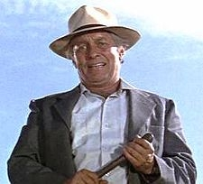
“. . . Failyuh to Communcate.”

Slide 20

Definition of “Cool”

Slide 21
How is Interpersonal Communication Different Than Other Forms of Communication?
Interpersonal communication involves face to face encounters
You are talking in person, not over a computer, phone or through written information
You can get immediate responses

Slide 22
How Does Interpersonal Communication Vary?
People and situations
You communicate differently with someone you know well verses a stranger
You will have different topics of conversation when talking to a customer, a manager or your best friend

Slide 23
Why is Interpersonal Communication Important?
You need it to develop throughout the stages of life
You learn, teach and get an identity through interpersonal communication
You also share with others who you are
You need interpersonal communication to:
pronounce words correctly
speak properly
communicate in general

Slide 24
We Use Interpersonal Communication for a Variety of Reasons
You use it to learn new information
You use it to define yourself
You also use it to fulfill the natural need for contact with other people
We learn about different cultures and languages
It gives you a human element, a real nature that other forms of communication can not provide

Slide 25
Techniques for Understanding People
Listen and observe by:
Putting the other person in the “spotlight”
Showing interest (take notes if a meeting)
Reading body language
Clarify meaning by:
Asking open ended questions
Paraphrasing
Responding, not reacting, to feeling

Slide 26
Majority of Time in Communicating is Listening

Slide 27
“Active Listening”
Requires concentration and energy
Involves a psychological connection with the speaker
Includes a desire and willingness to try and see things from another’s perspective
Requires that we suspend judgment and evaluation

Slide 28
Some Techniques for Active Listening
Commit to preparing a written summary before, or at the onset, of the conversation
Take notes
Write the summary

Slide 29

Open Ended Questions
Closed
Open
Are you on schedule?
Do you think we should do it differently?
Do you agree with this approach?
Is that your approach?
Are things going OK?
Do you realize you missed the deadline again?
What are the factors that are having the most impact on your schedule?
What are the ways that you think we should handle this problem?
How are you feeling about this approach?
Why do you feel that this is the best approach?
How are things going for you?
What problems are you having with the schedule that I could help with?

Slide 30
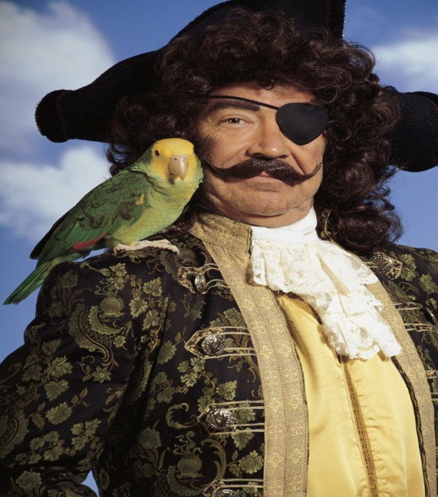
Paraphrasing
A concise statement of the content of the speaker’s message. Repeating back the speaker’s ideas in your words
A paraphrase should be brief, succinct and focus on the facts or ideas of the message rather than the feeling.
Paraphrase should be in the listener’s own words, not “parroting back” the speaker’s words
I was so angry at what he told me that. I think I'll cancel the whole order. I just need to figure out how to get the replacement part.
You thought you'd cancel the whole order?
If you didn't actually cancel the order,
we can still get the replacement part.

Slide 31
“PeopleSmart”
Eight skills to being "People Smart"
Associated Benefits
Understanding People
Expressing yourself clearly
Asserting your needs
Exchanging Feedback
Influencing Others
Resolving Conflict
Being a team player
Shifting Gears
When you understand someone else, you are appreciated.
When you explain yourself clearly, you are understood.
When you assert yourself, you are respected.
When you exchange feedback, you are enlightened.
When you influence others positively, you are valued.
When you resolve conflict effectively, you are trusted.
When you collaborate with teammates, you are prized.
When you shift gears, your relationships are renewed.

Slide 32
Four Step Process to Acquire “People Smarts”
You have got to want it.
You have got to learn it.
You have got to try it.
You have got to live it
Want it
Learn it
Try it
Live it

Slide 33


Sources of Training and Info
Microsoft one day internal class – Interpersonal Awareness
On line training – Interpersonal Communication from Hillsborough Community College, Tampa, FL $105, six weeks, new class starts up each month
http://www.ed2go.com/train/online_course/ipc/detail/Interpersonal_Communication.html
Training class local to DC area: ?
Northern Virginia Community College Interpersonal Communication CST 126
Offered twice a year
Uses the book "Interpersonal Communication: Everyday Encounters"
Quite expensive new but can be found used on Amazon for around $30.
Books
PeopleSmart Developing Your Interpersonal Intelligence
Hard Truth About Soft Skills
151 Quick Ideas to Improve Your People Skills
Listening The Forgotten Skill A Self Teaching Guide

Slide 34
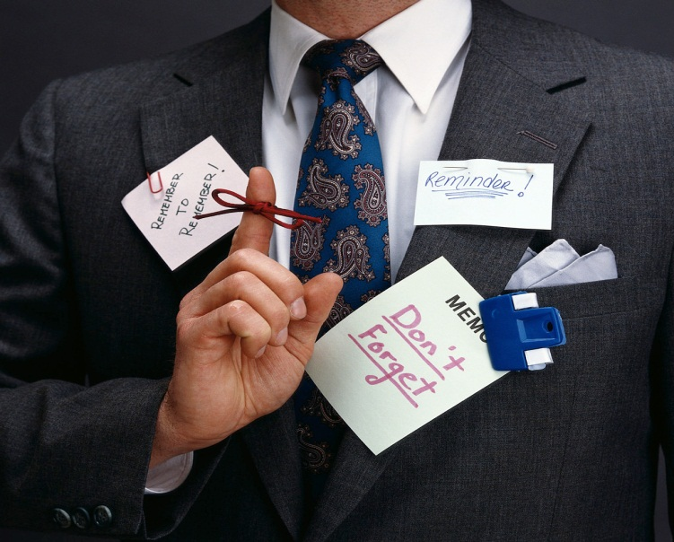
Essence of Interpersonal Awareness
Desire to understand other people

